Slide 1
Applied Data Science
Covering physical modelling, statistical modelling, regression, signal processing, nonparametric statistics, image processing, machine learning, artificial intelligence, plotting, visualisation, probablistic methods, deep learning, neural networks, random forests, data munging, relational databases, object databases, very large files, high performance computing, scientific computing, text mining, text generation and knowledge engineering

Slide 2
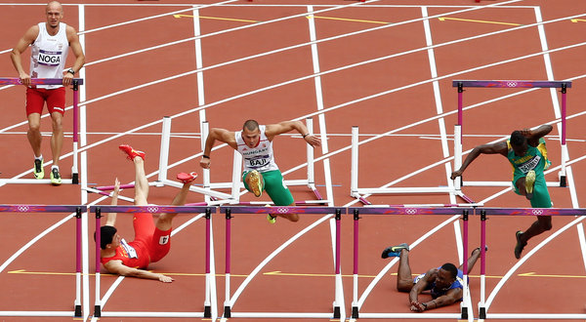
What Tutorials Are Like For Me

Slide 3
Se we’re going to spend 20 minutes on installing things… and then you can either do the exercises or just listen to the rest of the content

Slide 4
FIRST CLONE THIS REPO
https://github.com/tleeuwenburg/pyconau15
Or copy it from one of the USB keys (some additional data may be included on these)
INSTALL THE THINGS
try:
Install Script: part of the repo, pyconau15/install.sh
Except ScriptDidn’tWorkException:
Install Instructions: http://tinyurl.com/pqbwhpp
Except URLDidn’tWorkException:
Full url: http://myownhat.blogspot.com.au/ 2015/06/
setup-for-pycon-au-tutorial-take-one.html
Note for OSX users: conda install scipy=0.15.1 --force

Slide 5
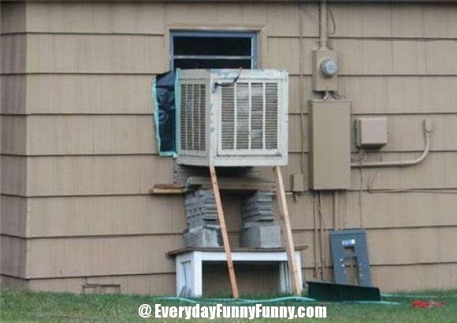
Still broken? Fix it yourself ☹

Slide 6
The AI Apocalypse
“I think we should be very careful about artificial intelligence. If I had to guess at what our biggest existential threat is, it’s probably that. So we need to be very careful.”
Elon Musk
http://www.theguardian.com/technology/2014/oct/27/elon-musk-artificial-intelligence-ai-biggest-existential-threat

Slide 7
The Cutting Edge
“There’s a big difference between intelligence and sentience. There could be a race of killer robots in the far future, but I don’t work on not turning AI evil today for the same reason I don’t worry about the problem of overpopulation on the planet Mars.”
Andrew Ng
http://www.theregister.co.uk/2015/03/19/andrew_ng_baidu_ai/

Slide 8
Spreadsheets
☹

Slide 9

What does a code monkey care?

Slide 10
Emerging Convergence of Paradigms
Vector and matrix data representation
Networked-array based information models
Convergence between image processing, text processing and statistical modelling
Physical modelling going its own separate way (more fundamental? Coming soon?)
Random forest; gradient boosting; convolutional networks; vector-based conceptual representation

Slide 11
Limitations and Bumps
Practical / data-munging: Handling poor data
Physical modelling and identifying causation
Machine Learning-Learning Techniques
Hypothesis Testing
Induction and deduction beyond correlation
Things just inexplicably don’t work sometimes
Adversarial examples challenge our ideas

Slide 12
Tech Grab Bag
Word2Vec
Deep Learning
Neural nets: Convolutional Networks, Recurrent Networks, Deep Networks
Other networks: random forests (decision trees), bayes networks, gradient boosting
Data preprocessing: augmentation, normalisation, feature extraction

Slide 13
We are about to cover all of this in the remaining 70-odd minutes.
Hopefully, with some time to spare.
If time allows, let’s try to solve something novel in the last twenty minutes.
Divided up into two practicals:
Mnist Digit Recognition (Random Forest)
Word2Vec (Neural Net)
Followed by discussion:
Validation, verification / Visualisation, attribution
BYOD (bring your own data)

Slide 14
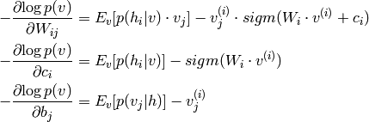
The Maths Hipster Tutorial
Omg this so easy
Made it even more easy for n00bs … lulz!
Here simple:
Yay results!

Slide 15
The Magician Tutorial
You just install this package…
And then feed in this completely canned, pre-processed input data
And you get this completely as-expected result
Then just customise for your use case lulz!

Slide 16
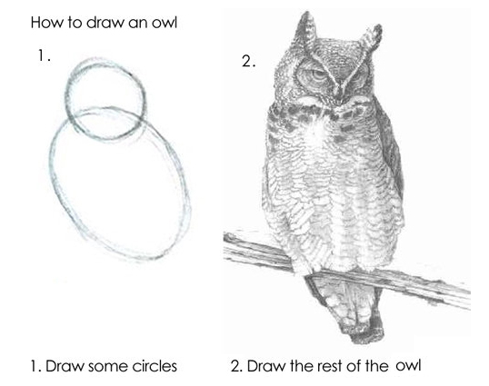
The Incomplete Tutorial

Slide 17
Fortunately for you, I’m both stupid and thorough
I can’t understand the maths without painstakingly explaining it to myself in tiny parts while referring to pictures
I also can’t customise black-box solutions to my own use case without fuller understanding
Result? This presentation: a breakdown of the theory and its application in simple terms even I can understand.

Slide 18
Get Thee Some Data
MNIST: https://github.com/tleeuwenburg/stml/blob/master/mnist/mnist.pkl.gz
Kaggle Otto competition data: https://www.kaggle.com/c/otto-group-product-classification-challenge
"Text8": http://mattmahoney.net/dc/text8.zip
For a stretch, try the larger data sets from http://mattmahoney.net/dc/textdata
Note – sample data is included in the repository

Slide 19
Reproducing Significant Results
Entree: Handwritten Digit Recognition
Main: Word Vectorisation
Dessert: Plotting and Shiny Things
Project Four: BYOD (bring your own data)

Slide 20
Breaking Down The Theory
Priming the Intuition:
Random Forests: ensembles are good
Neural Networks: good but explode randomly
Convolutional Networks: inherent structure
Word Vectorisation: suprising!

Slide 21
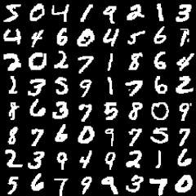
Session One -- Images

Slide 22
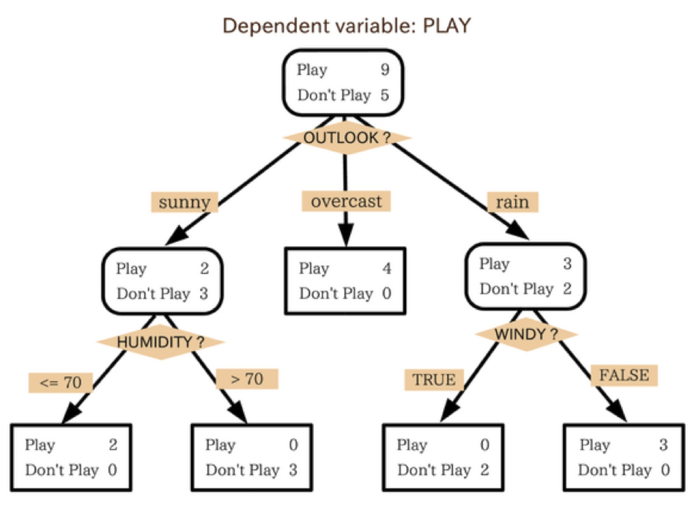
Random Forests

Slide 23
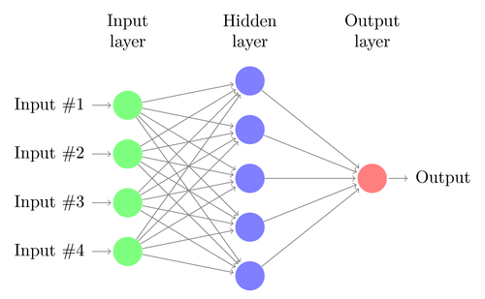
Basic Neural Net

Slide 24
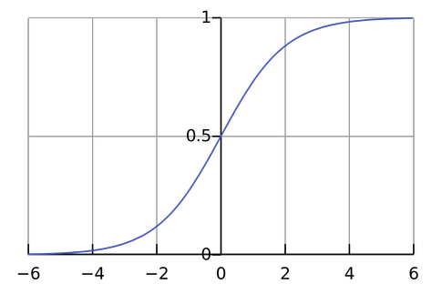
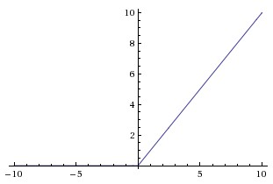
Activation Functions
SoftMax Activation
Linear Rectifier Unit

Slide 25
Session Two -- Text
Natural Language Processing
Natural Language Generation
Natural Language Understanding (ish)
Markov models, word2vec

Slide 26
Word2Vec Twitter Bot
Pick a body of knowledge to learn (corpus)
Represent that knowledge to the machine
‘One-hot’ representation of knowledge
What does a word vector mean?
The basis for all training: N-Grams

Slide 27
Testing Predictions
How do you know if you something is right?
Especially if you’re a sceptical person…
“Seems okay”
Worked on my machine
About as good as a weather forecast
As good as X within Y% likelihood
Accounts for Z% of the error

Slide 28
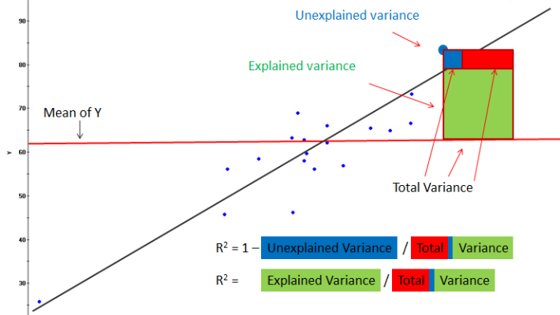
Percent Explained (R2)

Slide 29
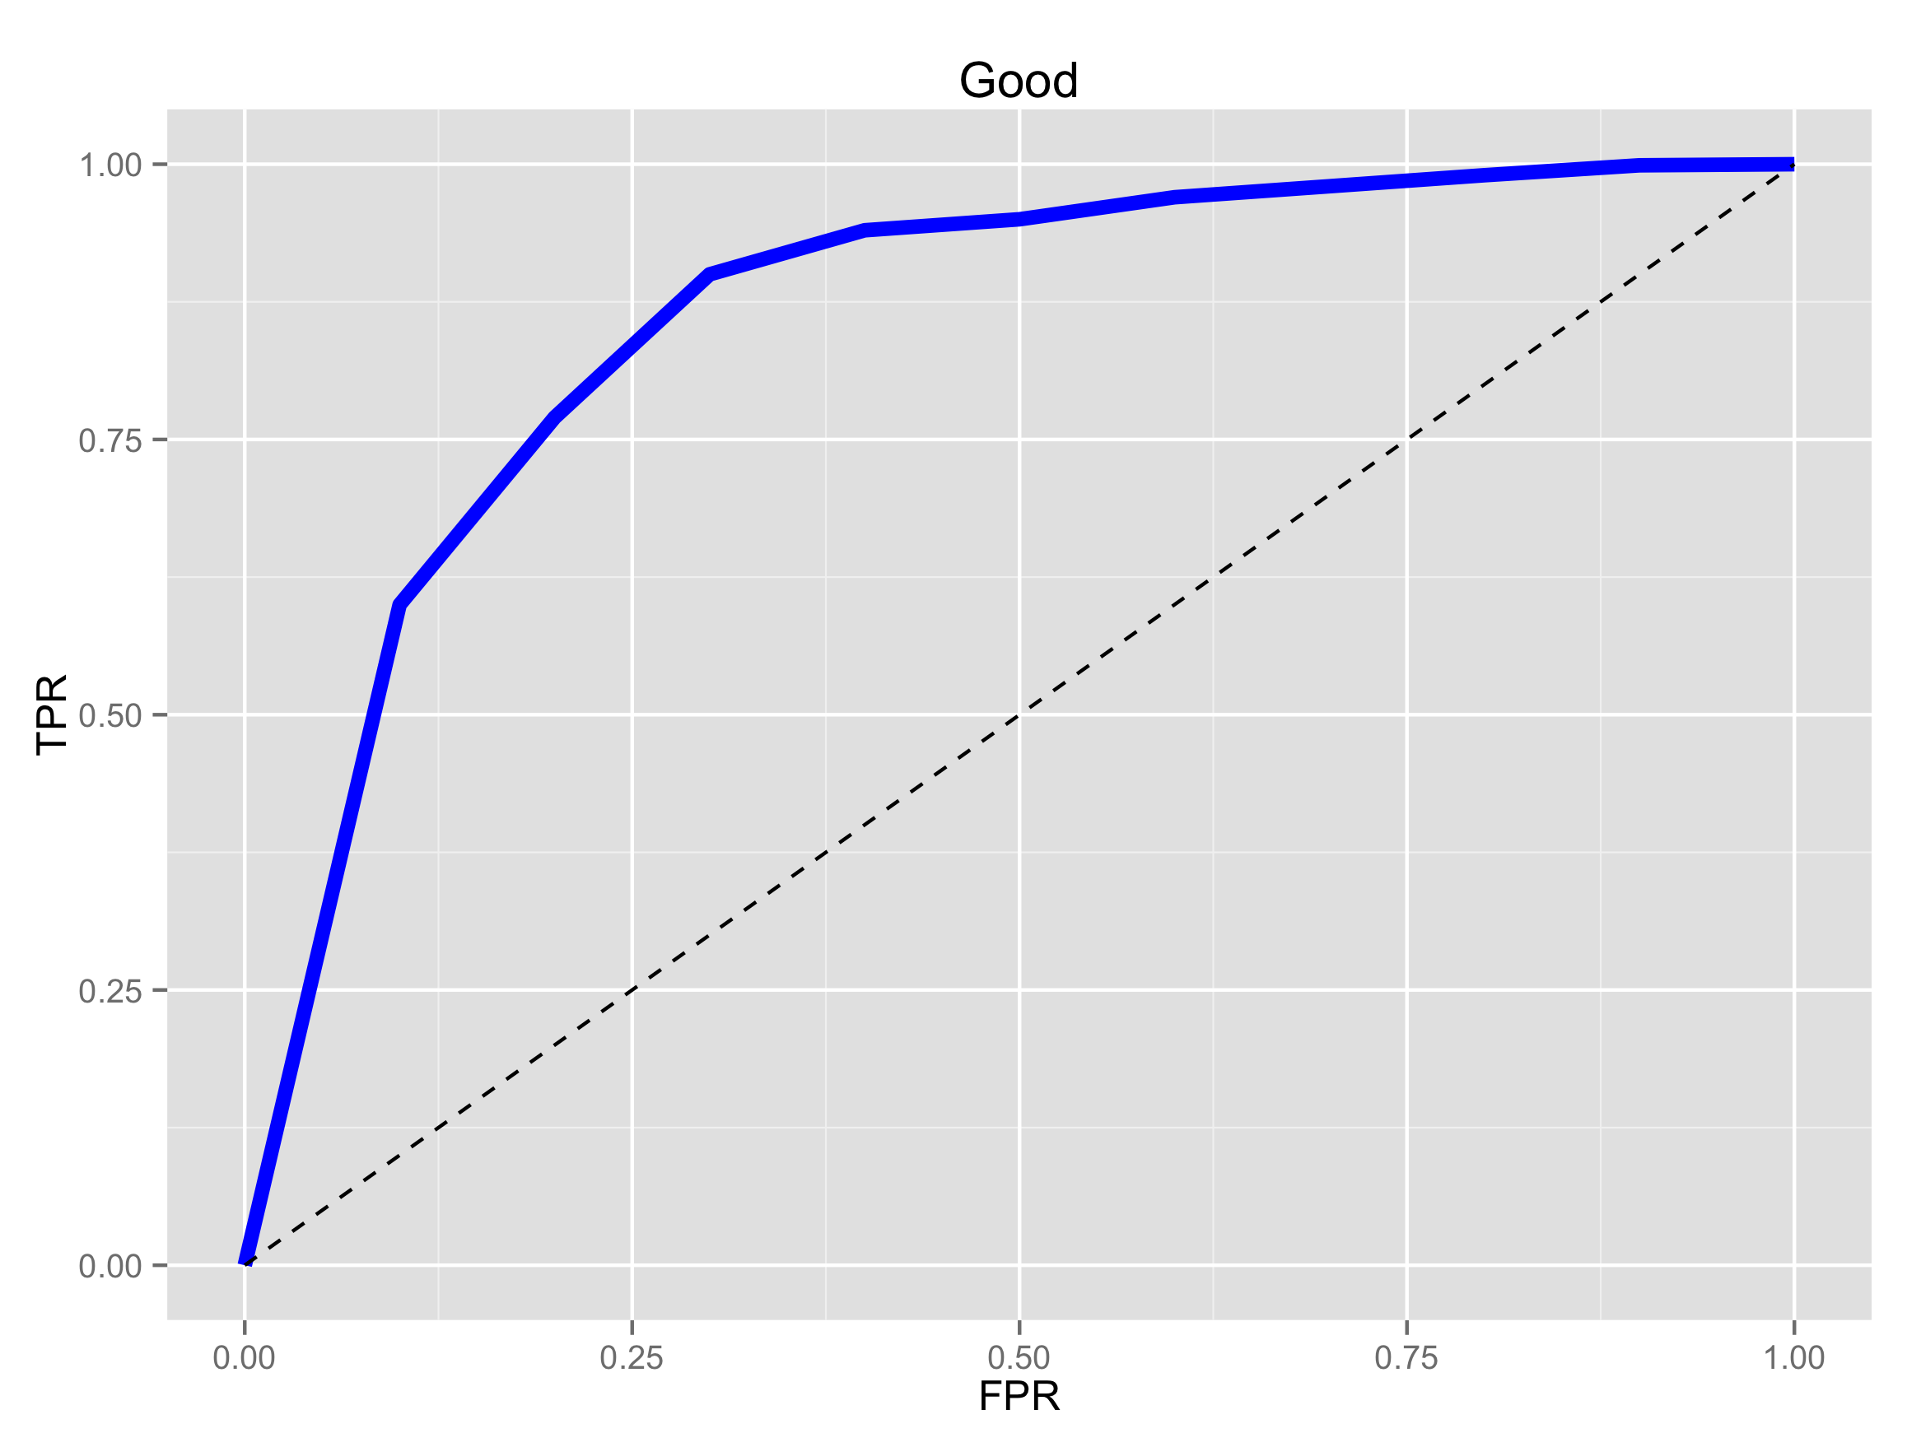
ROC Curves and AUC

Slide 30
Evaluating Data - Visual
Scatter Plot
Heap Map
Geographical Overlay
Time Views

Slide 31
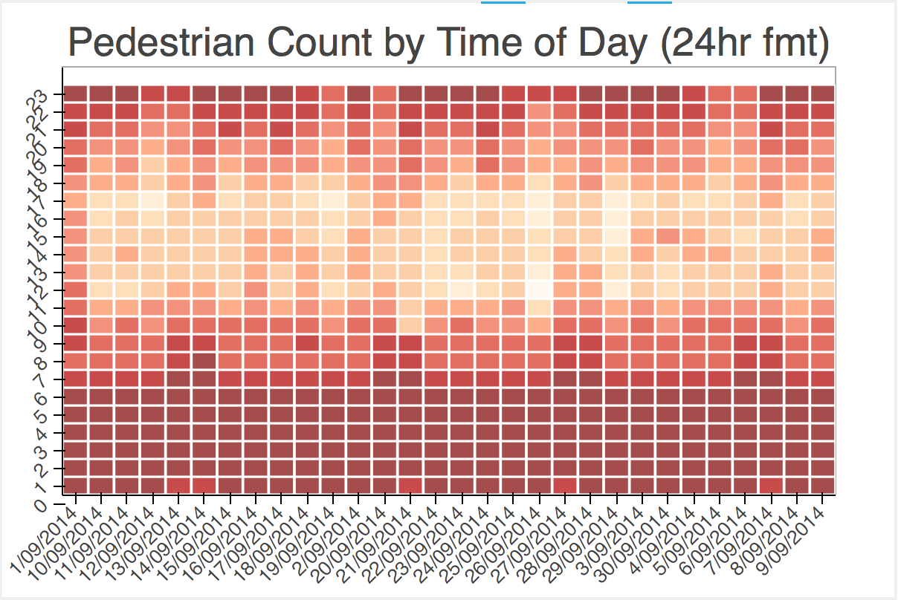
Heat Map

Slide 32
There are still some problems
The future may not be like the past
In predictable ways
In unpredictable ways
Obviously
Not-so-obviously
Nothing beats a causal explanation – what is the actual method of operation?
Same as saying – break the problem down

Slide 33
Solving New Problems
Theoretical approach: translate to another known problem to prove performance
Baseline against random forest
More attention needed on input biases
More attention needed on evaluation
Visualise All The Things

Slide 34
Directions in Data Science
Adverserial Examples
Automated Discovery of Solutions
Deep Dreaming (just cool, reveals biases)
Advanced Visualisation
Integration of Systems and Knowledge
That just leave the data munging… ☹

Slide 35
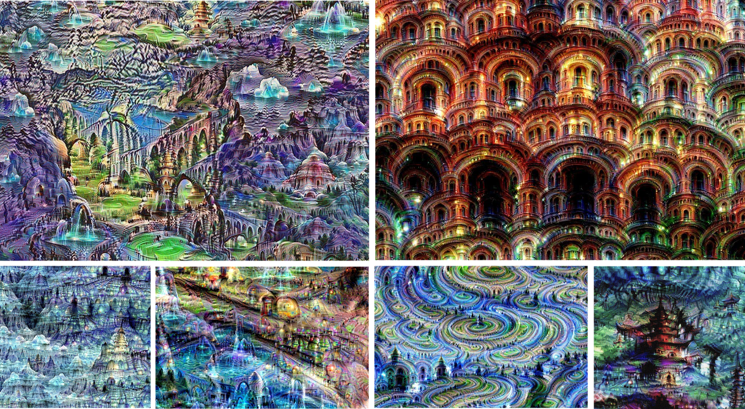
Deep Dreaming

Slide 36
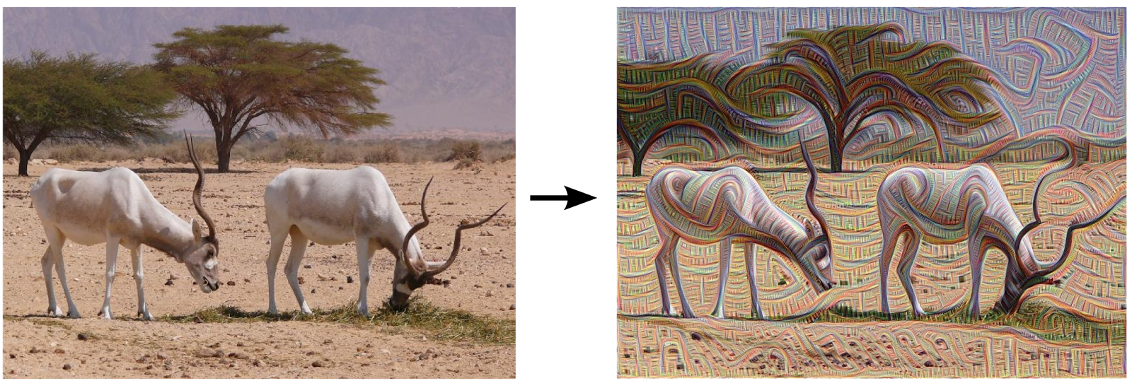
Deep Dreaming

Slide 37
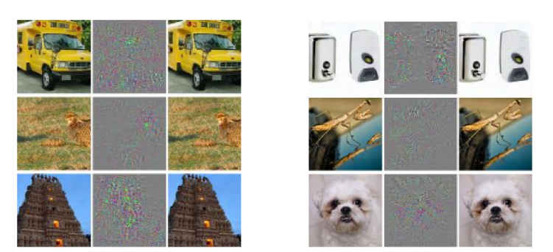
Adverserial Examples

Slide 38
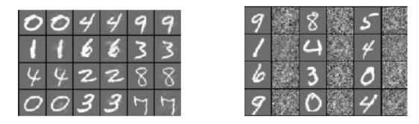
More Adverserial Examples

Slide 39
References
http://arxiv.org/pdf/1301.3781.pdf
http://arxiv.org/pdf/1312.6199.pdf
https://www.youtube.com/playlist?list=PL6Xpj9I5qXYEcOhn7TqghAJ6NAPrNmUBH ← this is the best machine learning lecture series, by Hugo Larochelle.

Slide 40
Exciting things to try
https://studio.azureml.net/
https://www.kaggle.com/

Slide 41
Python Has It All!
Install anaconda distribution, v3.4
O/S install: OpenBLAS (ymmv)
Install, in order: numpy & scipy (conda); theano, keras and word2vec (pip). Pandas and xray also useful.
You now have world-leading technology that is at the cutting edge of research and practise
Also … install CUDA and configure theano

